Slide 1
Conversion of tidal channel water to shallow As-rich groundwater through reduction of ferric oxides in the tidal deltaplain of SW Bangladesh
John C. Ayers^{1*}, chelsea peters²
¹Dept. of Earth & Env. Sciences, Vanderbilt University
(* correspondence: john.c.ayers@vanderbilt.edu)
² Dept. of Earth Sciences, Univ. of Delaware (cnpeters@udel.edu)

Slide 2
Abstract
Groundwaters in the shallow aquifer of the tidal deltaplain in Southwest Bangladesh are Na–Cl type and predominantly sulfate-reducing, with average conductivity SpC = 8 mS/cm, pH = 7.1, Eh = 13 mV, As = 40 ug/L, S = 5 mg/L, and high dissolved organic carbon of 11-57 mg/L [1]. Most groundwater samples from tubewells have As concentrations above the WHO drinking water guideline of 10 ug/L. This is usually attributed to reductive dissolution of hydrous ferric oxides such as goethite and mobilization of adsorbed As. We tested the hypothesis that these As-rich groundwaters formed by burial of Na-Cl type tidal channel water and progressive reduction by organic matter using a reaction path model in the Geochemists Workbench v. 14. Average groundwater salinity indicates an initial solution containing 20% saline dry season tidal channel water and 80% rainwater. This mixture has SpC = 8 mS/cm, pH = 7.4, Eh = 780 mV, As = 0.14 ug/L, and S = 127 mg/L. In the model 1 kg of solution is titrated with 4.5 mmoles of the reducing agent acetic acid in the presence of 10 mmoles of goethite. Adsorption onto goethite is described using the double layer surface complexation model. Progressive reduction consumes goethite, precipitates magnetite, and releases arsenic to solution. Next, sulfate is reduced to sulfide, which combines with dissolved ferrous iron to form pyrite. Dolomite precipitates early, followed by siderite at ~3 mmoles of reactant. Pyrolusite (MnO₂) precipitates and then dissolves. An inverse mass balance model in Phreeqc yields results similar to the forward model: progressive reduction causes dissolution of goethite and then precipitation of magnetite and then pyrite. The final solution has SpC = 8 mS/cm, pH = 7.9, Eh = -314 mV, As = 51 ug/L, and S = 0.0004 mg/L. Groundwater compositions mostly agree with model results, indicating that groundwaters are essentially connate waters, with variable but small amounts of dilution by recharge.
[1] Ayers et al. (2016) Geochem. Trans. 17:4, doi: 10.1186/s12932-016-0036-6

Slide 3
Notes
My final TE model used 80% RW – 20% TC May to get reasonable model As concentrations, but I still ended up reducing initial As 100x, so why not just stick with 80% TC Oct?
Actually, the concentrations in TCMay20%RW80%mixV2.rea are a mish-mash of values from different mixtures.
Tried using mixture in TCMay20%TCOct80%mix.rea but it won’t charge balance. Checked old scripts, and I reduced SO4 from 413.5 to 138, and used calcite saturation for Ca++
Couldn’t get that script to work, so I used the seemingly identical "C:\Users\ayersj.VANDERBILT\OneDrive - Vanderbilt\Projects\ONR\GW_Modeling\TC20%mix.rea“ which did work. Added the TE and returned SO4 to 413.5, and it worked. But the final fluid has too much SO4--. OK, it was mg/l as S (138), when it should have been as SO4 (413.5)
The new script is called “TCMay20%TCOct80%mix.rea”. Unlike the RW script, it swaps Eh for O2. But this makes the initial fluid more reducing, which changes the gas partial pressures significantly. So I swapped in O2 and set it at 100% saturation.

Slide 4
Introduction
Groundwaters in the shallow aquifer of the tidal deltaplain in Southwest Bangladesh are Na–Cl type and predominantly sulfate-reducing
Most groundwater samples from tubewells have As concentrations above the WHO drinking water guideline of 10 ug/L, with high average DOC of 11-57 mg/L
We tested the hypothesis that these As-rich groundwaters formed by
  burial of Na-Cl type tidal channel water
  progressive reduction of HFO goethite by organic matter, which released arsenic

Slide 5
Water
Compositions
Notes:
It makes sense to use a 80% TC Oct - 20% TC May mixture because this accounts for the fact that most precipitation and sediment deposition occurs in the wet season. It also makes sense to substitute 80% rainwater for TC Oct because evidence indicates there is freshwater (almost certainly meteoric) recharge, causing groundwater 14C ages to be about 1/3 of the depositional age (Worland and others). In the end it doesn't matter because TC Oct water is so dilute that the substitution doesn't significantly affect the initial composition (*include both in table for comparison) and the results.

Slide 6
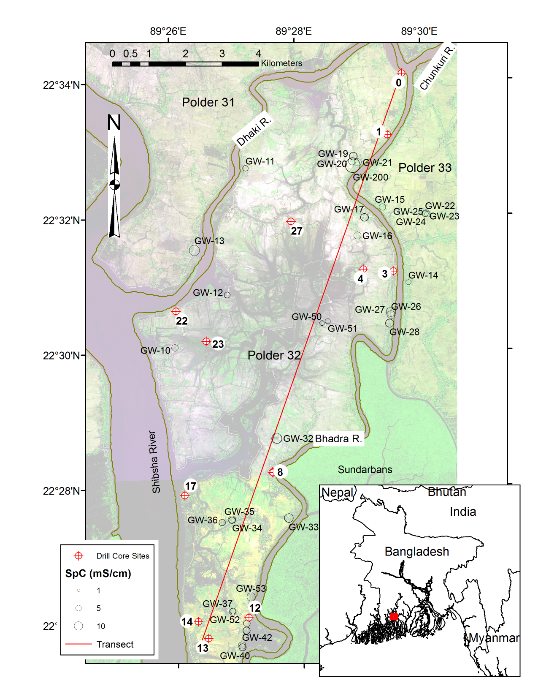
Groundwater samples collected from tubewells on Polder 32 in SW Bangladesh, 2012-2013
Ayers et al., 2016

Slide 7
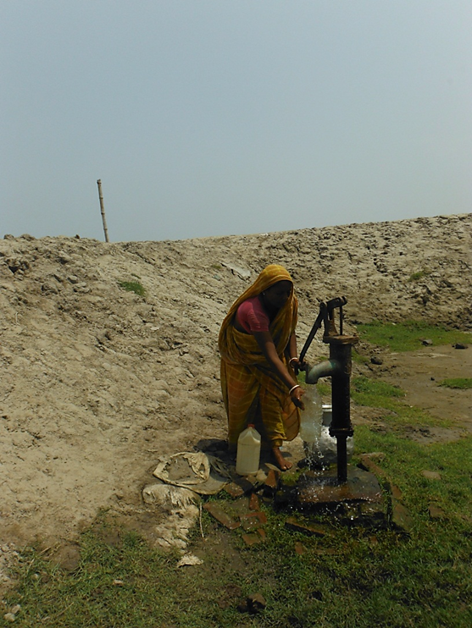

Drinking Water
Groundwater from upper aquifer
Surface water pond
Surface water universally contaminated with microbial pathogens and anthropogenic pollutants (Michael and Voss, 2009).
Groundwater is primary source of drinking water for more than 150 million inhabitants of Bangladesh (Michael and Voss, 2009).
Notes:
Shallow aquifer has higher concentrations of salinity and arsenic than surface water sources.
Salinity concentrations in groundwater within the study area range from 1,873 to 8,890 μS/cm (BADC, 2011) ~ 1 to 5 ppt.
Kidney disease and Renal Failure.
Arsenic > 50 ppb.
Carcinogen.

Slide 8
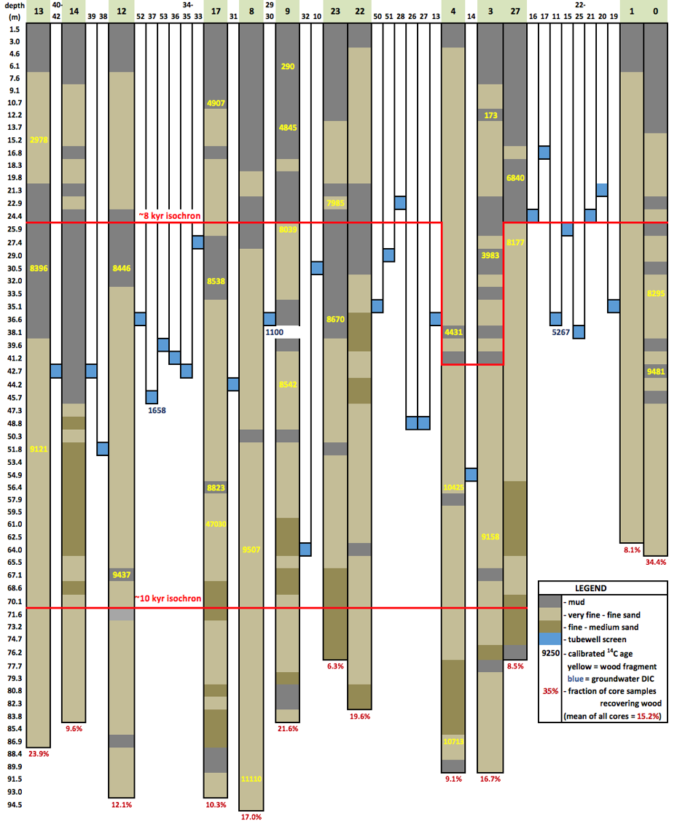
Subsurface stratigraphy
Ayers et al., 2016

Slide 9
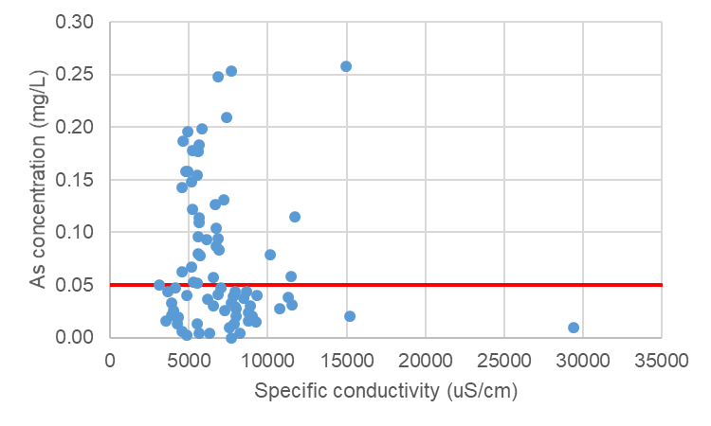
Groundwater Quality
Ayers et al., 2016

Slide 10
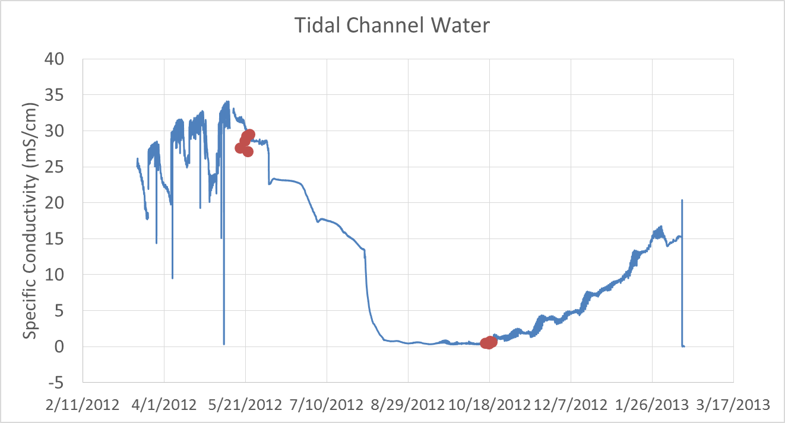
Seasonal changes in tidal channel water composition
Ayers et al., 2017

Slide 11
Water compositions
Average of groundwater compositions from samples collected from tubewells in 2012-2013 (bottom right) has major ion concentrations similar to a mixture of 80% average October (wet season) and 20% average May (dry season) tidal channel water.

Slide 12
GW and average tidal channel water compositions

Slide 13
React model
Reaction path model in GBW React v. 14 used to simulate progressive reduction of buried surface water mixture.
Initial solution containing 20% saline dry season tidal channel water and 80% wet season tidal channel water.
This mixture has SpC = 8 mS/cm, pH = 7.4, O2 saturated at 8.3 mg/L, As = 10 ug/L, and S = 127 mg/L.
Acetate is used as the reducing agent because it is produced from organic matter by microbial fermentation and anaerobic oxidation and then consumed in acetotrophic sulfate reduction and acetoclastic methanogenesis (Bethke, 2007).
Adsorption onto goethite is described using the double layer surface complexation model.

Slide 14
TCOct80%TCMay20%mix.rea script
# React script, saved Wed May 27 2020 by ayersj
data = thermo.tdat verify
surface_data = FeOH+.sdat
conductivity = conductivity-USGS.dat
temperature = 30 C
H2O = .992896 free kg
O2(aq) = 8.25 mg/l
pH = 7.64
HCO3- = 149.6 mg/l as CO3--
Cl- = 2566 mg/l
balance on Cl-
SiO2(aq) = 3.34 mg/l as Si
SO4-- = 413.5 mg/l
HPO4-- = .063 mg/l as P
Na+ = 1702 mg/l
Mn++ = .0296 mg/l
Mg++ = 167 mg/l
K+ = 70.1 mg/l
swap Goethite for Fe++
Goethite = 3 free mmol/kg
swap Calcite for Ca++
Calcite = 5 free mmol/kg
Al+++ = .0256 mg/l
As(OH)4- = .007 mg/l as As
Ba++ = .038 mg/l
Co++ = 3.64e-5 mg/l
Cr+++ = .00143 mg/l
Cu+ = .00237 mg/l
Ni++ = .000185 mg/l
swap SeO4-- for SeO3--
SeO4-- = .00189 mg/l as Se
Sr++ = .187 mg/l
V+++ = .00265 mg/l as V
react 4.47 mmol of CH3COO-
suppress all arsenic minerals

Slide 15
System variables
Notes:
TCOct80%TCMay20%mix.rea

Slide 16
Gas partial pressures
Notes:
TCOct80%TCMay20%mix.rea

Slide 17
Schoeller diagram
Notes:
TCOct80%TCMay20% with 2020GW_CalculatedBicarbonate.gss as scatter data

Slide 18
Piper diagram
Notes:
GW scatter with TCOct80%TCMay20%mix.rea trace

Slide 19
Minerals
Goethite + .04167 CH3COO- = .04167 H+ + .5 H2O + .3333 Magnetite + .08333 HCO3-
2.167 H+ + .3333 Magnetite + 1.833 CH3COO- + 2 SO4-- = Pyrite + 2 H2O + 3.667 HCO3-
.9167 H+ + .3333 Magnetite + .08333 CH3COO- + .8333 HCO3- = Siderite + H2O
An inverse mass balance model in Phreeqc yields results similar to the forward model: progressive reduction causes dissolution of goethite, precipitation of magnetite and then pyrite and siderite.
Notes:
TCOct80%TCMay20%

Slide 20
Reductive dissolution of goethite and precipitation of pyrite

Slide 21
HFO goethite properties

Slide 22
Inverse mass balance modeling of groundwater in Phreeqc
SOLUTION 1 TC May 20%, TCOct 80%
temp 25
pH 7.54
pe 4
redox O(-2)/O(0)
units mg/l
density 1
C(4) 32
Ca 65
Cl 2566 charge
Fe 1e-07
Mg 167
Na 1702
O(0) 8.25
S(6) 138 -water 1 # kg
SOLUTION 2 Avg. groundwater
temp 25
pH 7.09
pe 0.21
redox O(-2)/O(0)
units mg/l
density 1
C(4) 983.8
Ca 155
Cl 2454 charge
Fe 4.09
Mg 136.7
Na 1292
O(0) 1.3e-054
S(6) 12.9
-water 1 # kg
PHASES
CH3COOH
CH3COOH = 1CH4 + 1CO2
log_k 0
Magnetite
Fe3O4 + 8H+ = Fe+2 + 2Fe+3 + 4H2O
log_k 0
INVERSE_MODELING 1
-solutions 1 2
-uncertainty 0.09 0.09
-phases
Pyrite pre
Goethite dis
Magnetite
Calcite
O2(g) dis
CH4(g) pre
CO2(g)
Dolomite
CH3COOH dis
Siderite pre
-balances
Cl 0.09 0.09
Na 0.09 0.09
-range 1000
-tolerance 1e-10
-mineral_water true
END

Slide 23
Inverse mass balance model results: one of 10 solutions
Solution fractions: Minimum Maximum
Solution 1 6.340e-01 6.340e-01 6.380e-01
Solution 2 1.000e+00 1.000e+00 1.000e+00
Phase mole transfers: Minimum Maximum
Pyrite -4.312e-04 -4.405e-04 -4.253e-04 FeS2
Goethite 2.710e+01 2.680e+01 2.710e+01 FeOOH
Calcite 1.118e-03 1.094e-03 1.142e-03 CaCO3
CH4(g) -2.033e+01 -2.034e+01 -2.010e+01 CH4
Dolomite 2.178e-03 2.153e-03 2.178e-03 CaMg(CO3)2
CH3COOH 2.372e+01 2.345e+01 2.372e+01 CH3COOH
Siderite -2.710e+01 -2.710e+01 -2.680e+01 FeCO3
Notes:
One of 10 possible solutions Only missing magnetite

Slide 24
Arsenic mobilization
Notes:
TCOct80%TCMay20% with 2020GW_CalculatedBicarbonate.gss as scatter data

Slide 25
Fluid vs. Sorbate concentrations
Notes:
TCOct80%TCMay20% Linear relationship caused by decreasing amount of sorbate over reaction path. As shows (-) correlation in both models, but Se shows + correlation in this model – why?

Slide 26
Sorbed fractions
Notes:
TCOct80%TCMay20%

Slide 27
Change in fluid concentrations of trace elements
Notes:
TCOct80%TCMay20%

Slide 28
Conclusions
Groundwater compositions mostly agree with model results, indicating that groundwaters are essentially connate waters.
During burial, porewater reacts with sedimentary or dissolved organic carbon.
Progressive reduction consumes goethite, precipitates magnetite, and releases arsenic and other trace elements to solution.
Next, sulfate is reduced to sulfide, which combines with dissolved ferrous iron to form pyrite.
Dolomite precipitates early, followed by siderite.

