Slide 1
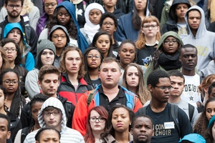
Vanderbilt University- Arts and Science Efforts for Greater Equity, Diversity and Inclusion at VU
George C. Hill, Ph.D
Professor of Molecular Physiology
Vice Chancellor for Equity, Diversity and Inclusion
Chief Diversity Officer
February 16, 2016

Slide 2
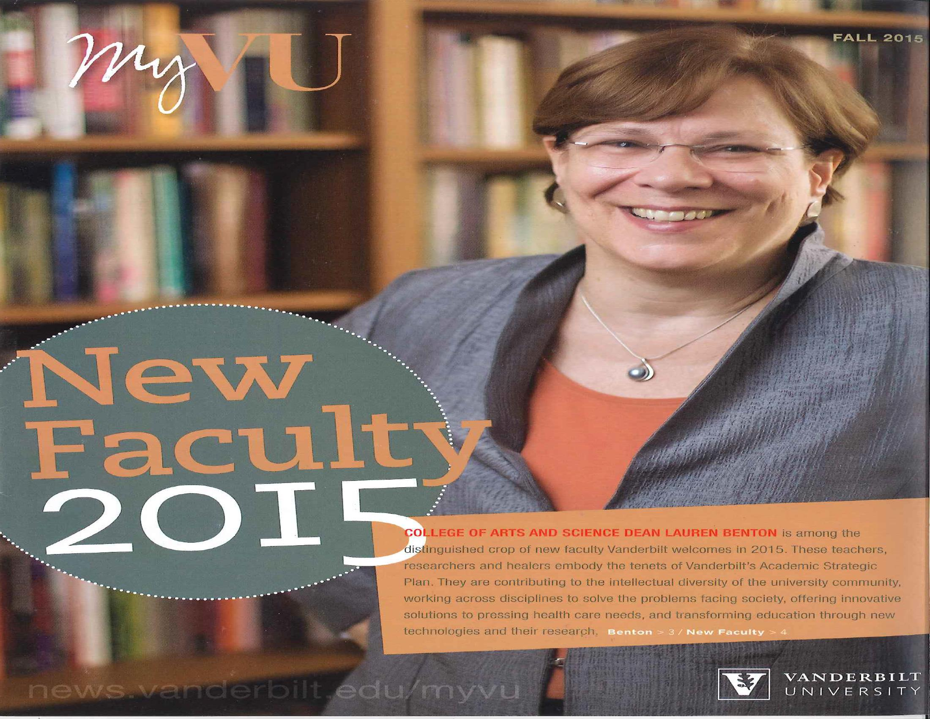

Slide 3
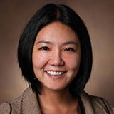
A&S Teaching Awards
The Ernest A. Jones Faculty Adviser Award was awarded to Haerin Shin, assistant professor of English
Carrie Russell, senior lecturer in political sciences, Harriet S. Gilliam Award for Excellence in Teaching by a Senior Lecturer or Lecturer
Roy Gottfried, professor of English, received the Nordhaus Award in the humanities
Bruce Hughes, professor of mathematics, received the Nordhaus Award in the natural sciences
Richard Pitt, associate professor of sociology, received the Nordhaus Award in the social sciences.
Elizabeth Zechmeister, professor of political science, was honored with the Award for Excellence in Graduate Teaching
Richard Haglund, Stevenson Professor of Physics, was presented the Award for Excellence in Graduate Mentoring.

Slide 4
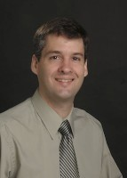
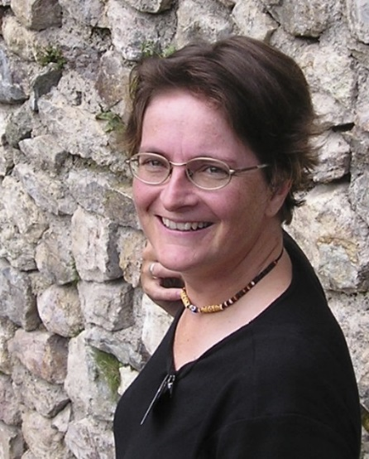
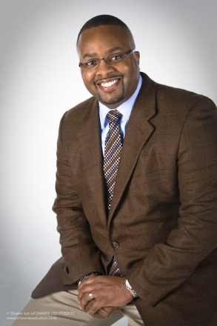
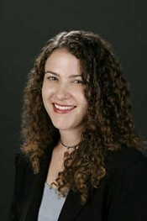
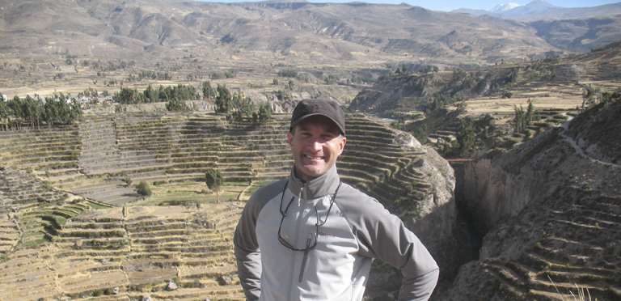
A&S 2016 Chancellor Faculty Fellows
Derek Griffith
Associate professor of medicine, health and society
Julian Hilyer
Associate professor of biological sciences
Betsey Robinson
Associate professor of art, anthropology and classics
Catherine Molineux, Associate professor of history
Steve Wernke. Associate professor of anthropology

Slide 5
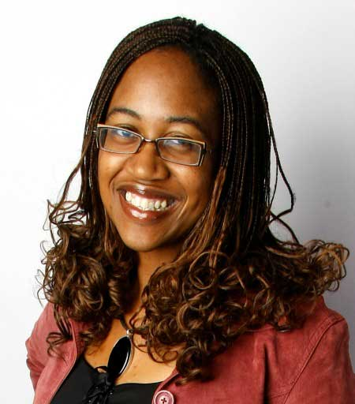
Chancellor’s Higher Education Fellow – Associate Professor of English and Associate Professor of Teaching and Learning and Director of American Studies Ifeoma Nwankwo

Slide 6
Question??
How do we facilitate serious discussion and study of diversity with all its dimensions within the academic experience at Vanderbilt University?
What responsibility do Arts and Sciences Faculty have to make this happen?

Slide 7
Equity, Diversion and Inclusion Major Priority for Chancellor
“If Vanderbilt does not address issues of diversity, inclusion and culture, and instead acts like everything is just fine, it will fail as an institution.
This is a project of great importance. It is the most important thing I’m going to be spending my time on.
At the center, it’s really a matter of race. It is America’s most fundamental challenge.”
Chancellor Zeppos
August 27 2015

Slide 8
Supreme Court- December 9 2015
What unique perspective does a minority student bring to a physics class?
I’m just wondering what the benefits of diversity are in that situation?
- Chief Justice Roberts

Slide 10
Top Priorities
Develop a Timeline for Progress
Establish a Student Advisory Committee
Hold Listening Sessions around campus
Meet National Diversity Experts here in Spring
Collaborate on Faculty Climate Survey
Establish a Mentor Database
Prepare a Diversity Snapshot
Develop a Vice Chancellor and Deans Report Card

Slide 11
VU Faculty Climate Survey
Overall, do you feel the university is an inclusive environment for community members from all backgrounds?
How satisfied are you with the university’s efforts to recruit a diverse faculty?
How satisfied are you with the university’s efforts to retain a diverse faculty?

Slide 12
Recent Proactive Steps
Appointment of Vice Chancellor and Chief Diversity Officer
Appointment of Associate Dean for Equity, Diversity and Inclusion in Peabody and Engineering
Committee charged by Provost with recommending new University Courses designed to advance diversity and equity
Establishment of Center for Student Wellbeing
Appointment of assistant director for access and inclusion in the Psychological and Counseling Center

Slide 13
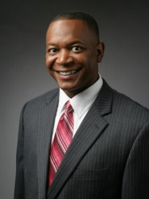
Multicultural University Courses
C. André Christie-Mizell, Ph.D.
The Office of the Provost has charged a faculty committee with assessing proposals for new Multicultural University Courses. The new courses, will address topics tied to diversity, equity and inclusion, race and ethnicity, identity literacy, and/or cultural competency within an interdisciplinary setting.

Slide 14
Chancellor’s Committee on Diversity, Inclusion and Community
Co- chairs:
Keivan Stassun- Professor of Astronomy
Beverly Moran- Professor of Law
Joe Bandy- Executive Chair
“If Vanderbilt does not address issues of diversity, inclusion and culture, and [instead] acts like everything is just fine, it will fail as an institution,”
Chancellor Zeppos
https://www4.vanderbilt.edu/diversity-inclusion-community-committee/

Slide 15
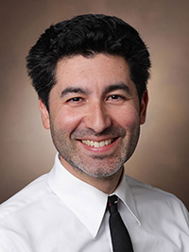
Deans Diversity Council
Keivan Stassun, Ph.D.
Professor of Astronomy
Senior associate dean for graduate education and research

Slide 16
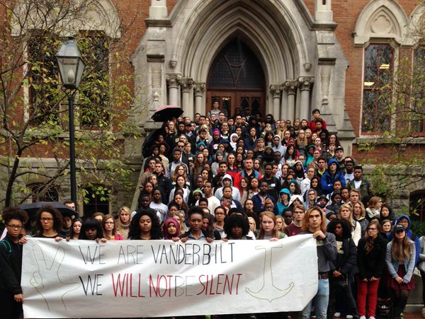
November 17 2015

Slide 17
Initiated from a desire to highlight
the experiences of students of color on
Vanderbilt's campus, the Hidden Dores
Movement began in the spring of 2014
as a photo campaign to display instances
of marginalization on campus.
Now the organization has grown to
encompass several committees that work
to induce structural change in our university
and stimulate conversations about the
identities and marginalization of students
of color at Vanderbilt.

Slide 18
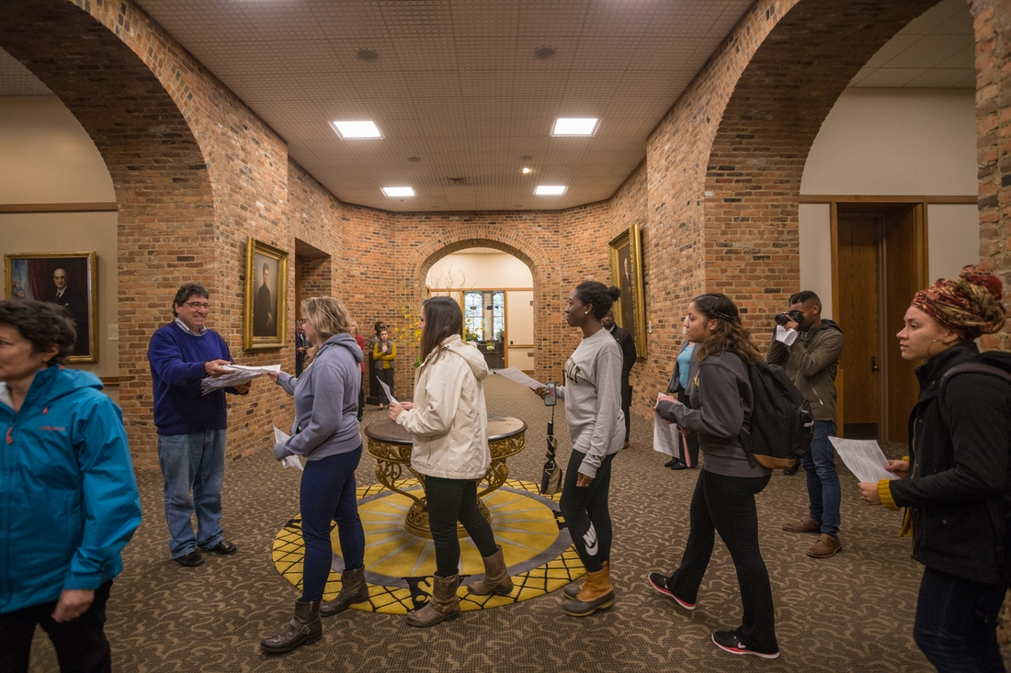
November 17 2015

Slide 19
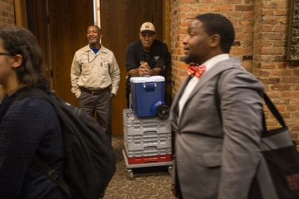

Slide 20
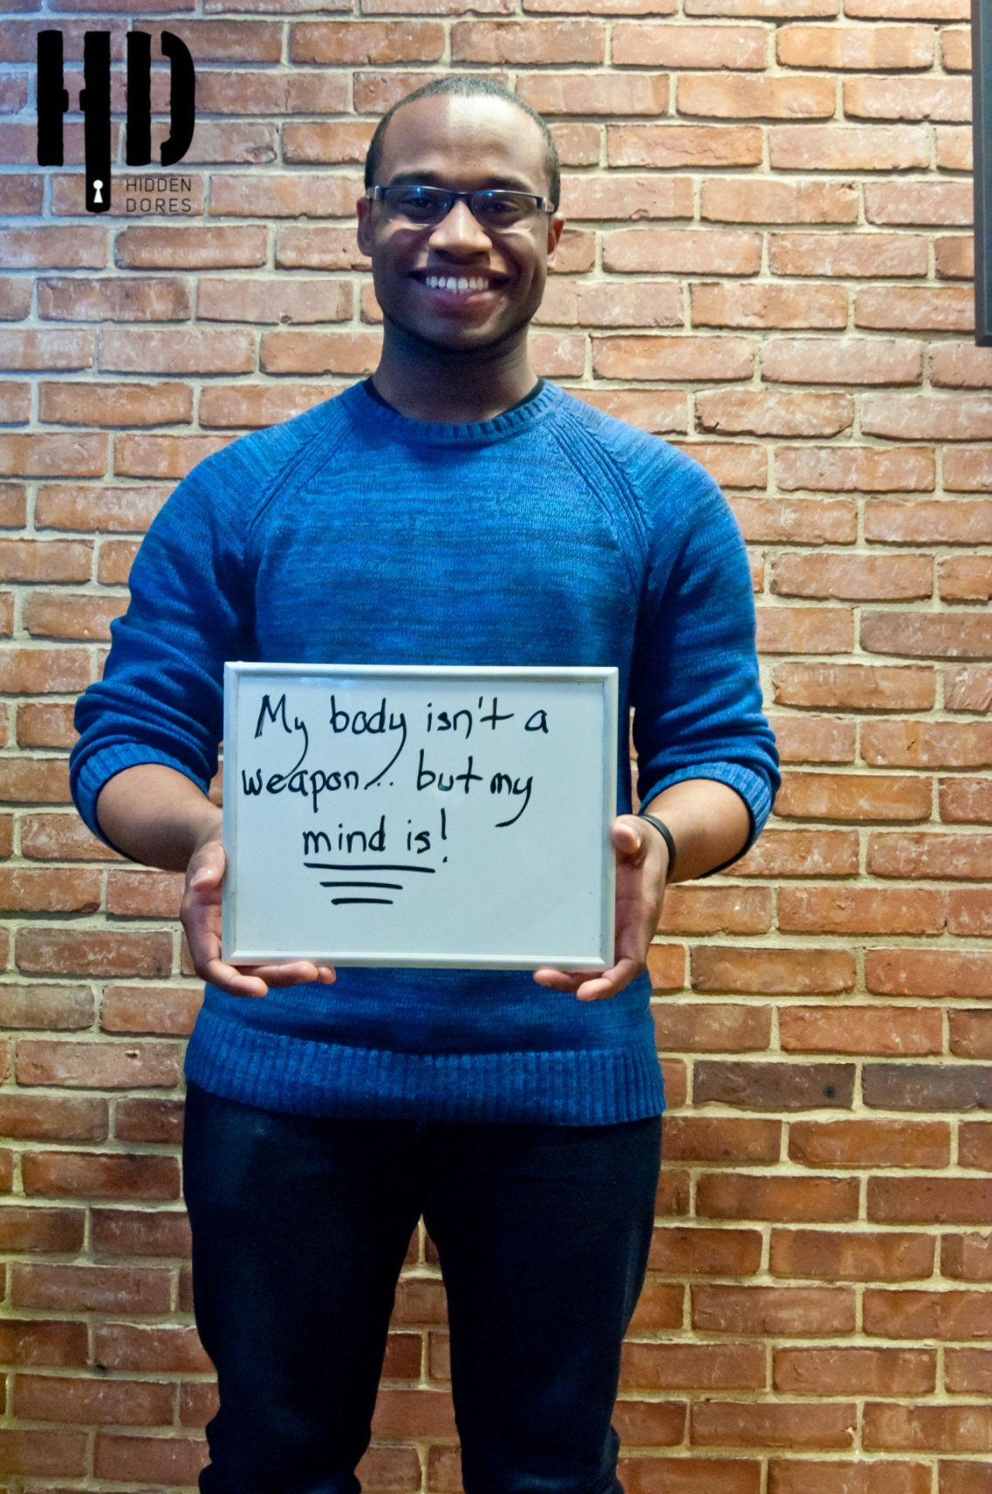

Slide 21
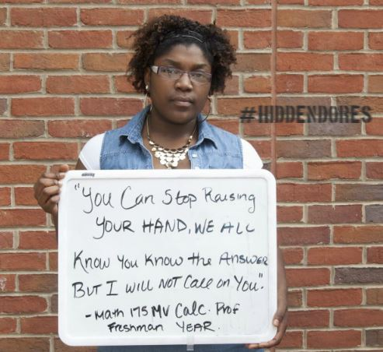

Slide 23
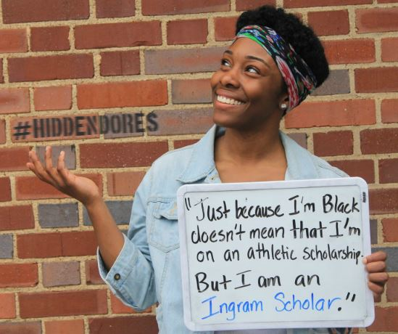

Slide 24
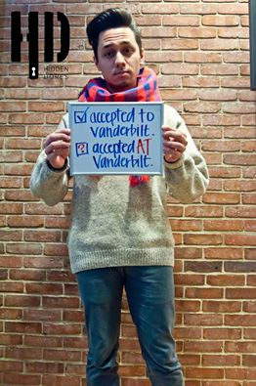

Slide 25
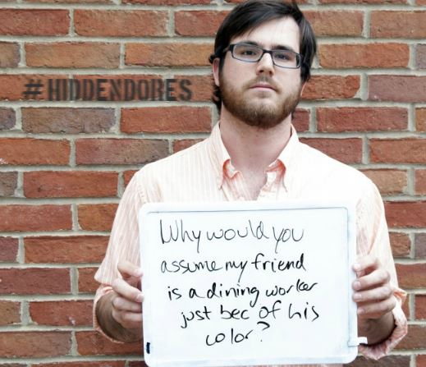

Slide 26
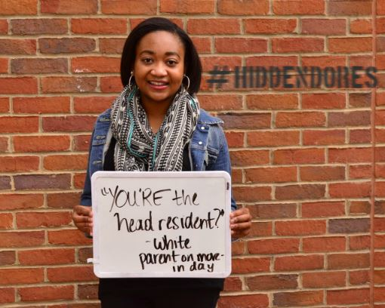

Slide 28
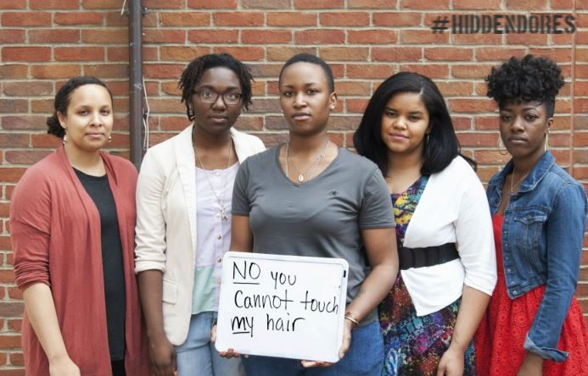

Slide 29
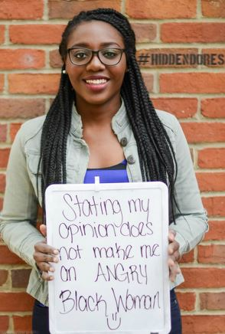

Slide 30
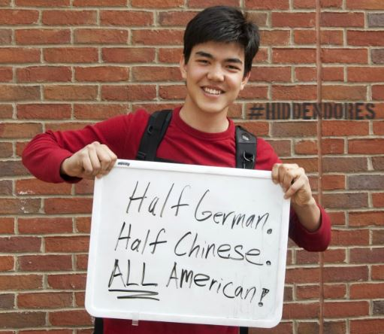

Slide 31
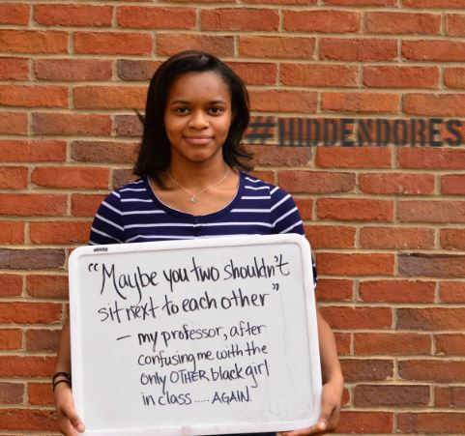

Slide 32
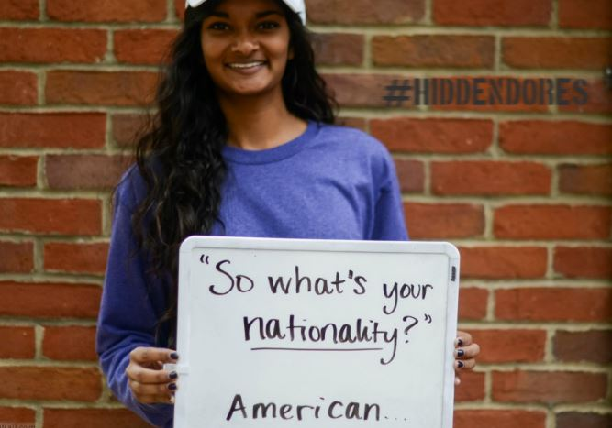

Slide 33
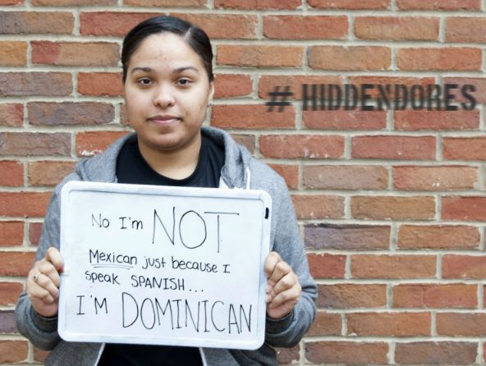

Slide 35
VU Student Demands
1. Mental Health
2. Curriculum
3. Staff
4. Accountability
5. Policy

Slide 36
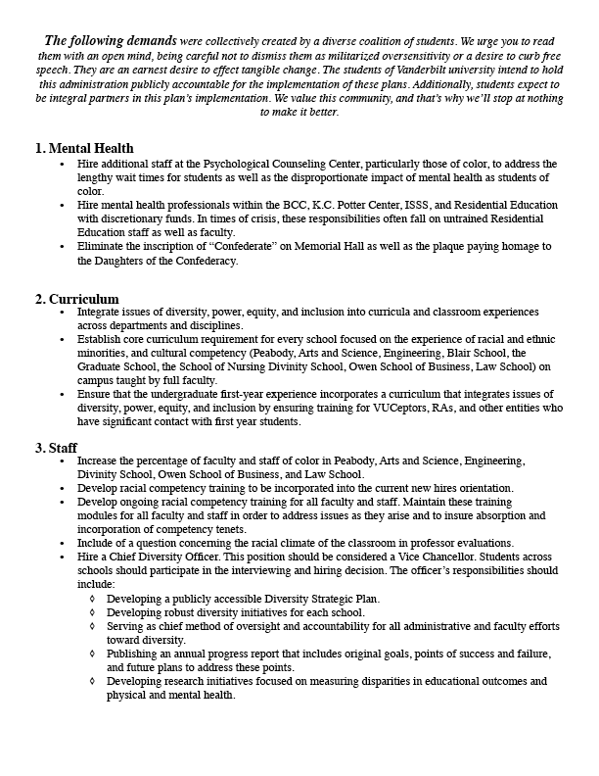

Slide 38
Tenured and Tenure Tract Faculty in A&S
Gender: 30.8% female- 69.2% male (A&S, tenured, tenure-track, fall 2015)
Demographics: URM % for A&S in 2015 is 10.2% and increases to 15.8% when Asian, Pacific Islander and 2 or more races are included
The white percent for the same group is 80.4%.

Slide 41
Question??
How do we facilitate serious discussion and study of diversity with all its dimensions within the academic experience at Vanderbilt University?
What responsibility do we as Arts and Sciences Faculty have to make this happen?

Slide 42
Challenges for Arts and Sciences
Recruitment and retention of minority and female faculty
Increasing the number of minority students who apply, matriculate and graduate from graduate programs.
Increasing the participation of minority students in the STEM fields
Addressing student interest of a multicultural course requirement during matriculation at VU
??

Slide 43
Problem to Solve
Bletchley Park

Slide 44
Problem to Solve
Bletchley Park - Bletchley Park is a place of exceptional historical importance. It remains highly relevant to our lives today and for the future. It is the home of British codebreaking and a birthplace of modern information technology. It played a major role in World War Two, producing secret intelligence which had a direct and profound influence on the outcome of the conflict.

Slide 45
Who would you want to work on the Project??

Slide 46
The diverse group always outperforms the group of the “best” by a substantial margin
The people who do the best alone tend to have similar tools while a diverse group includes people who have different tools or strengths.
See Lu Hong and Scott Page (PNAS 2002)

Slide 47
Scott Page- The Difference
By seeing problems differently (diverse perspectives) and by looking for solutions in different ways (diverse heuristics), teams, groups, organizations can locate more potential innovations.
Scott E. Page Ph.D.
Professor of Complex Systems
University of Michigan

Slide 48
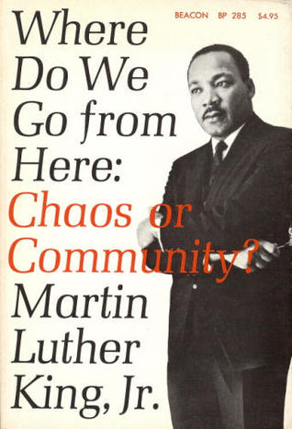
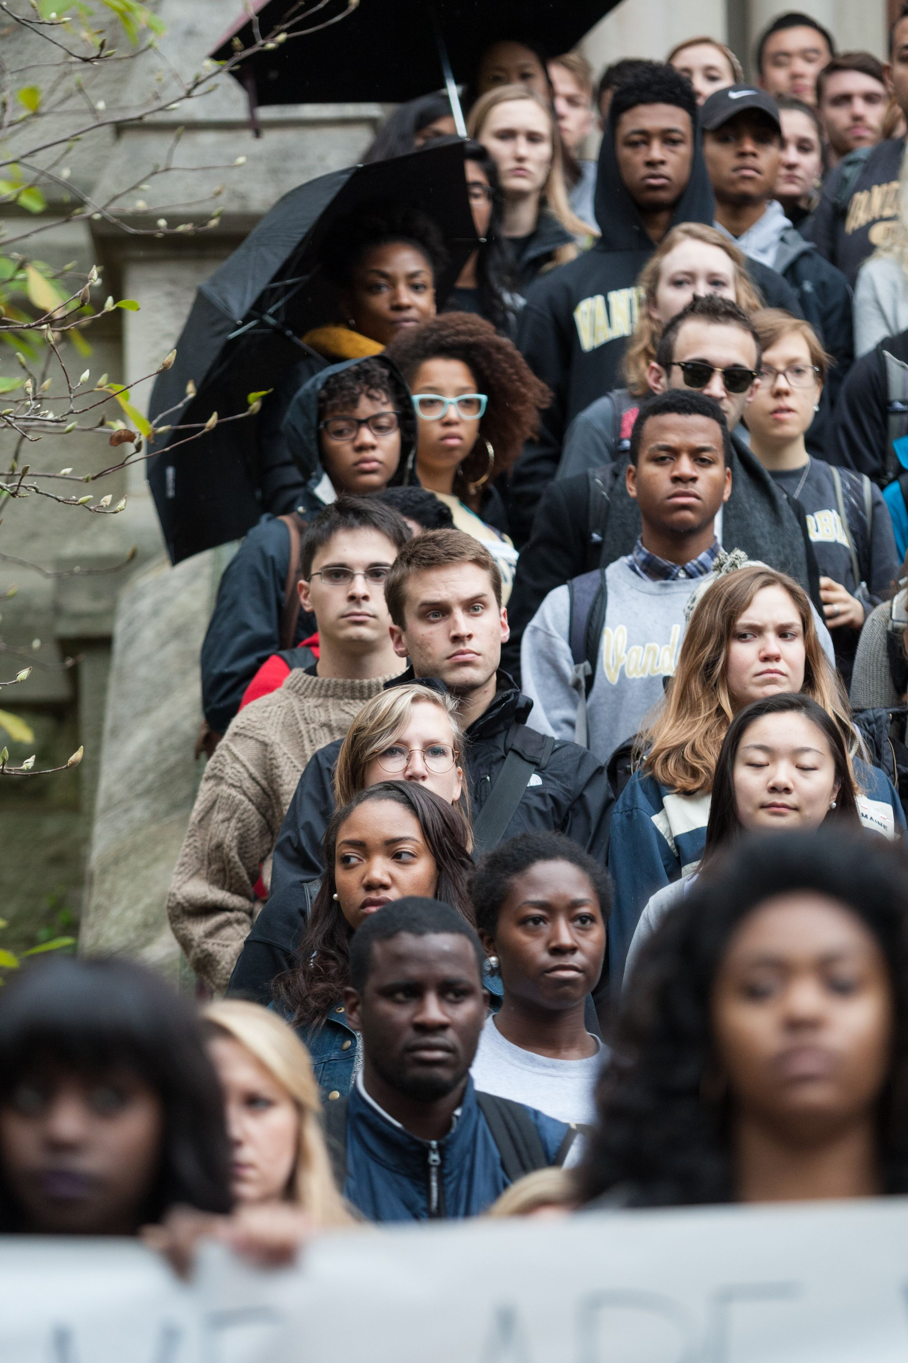

Slide 49
Next Action Steps – July 1 2016
Collaborate
Report from Committee for Diversity, Inclusion and Community – July I 2016
Address the request for specific courses that students will have available to take in equity, diversity and inclusion
Further implementation and evaluation of the Provost guidelines for filling academic appointments
Complex but Urgent

Slide 50
Contact Information george.hill@vanderbilt.edu
George C. Hill, Ph.D.
Vice Chancellor for Equity, Diversity and Inclusion
Professor pf Molecular Physiology and Biophysics
401 Kirkland Hall
615-936-0721
615-309-4533 - cell

