Slide 1
Incorporating MOOCs into Traditional Courses
Douglas H. Fisher
Vanderbilt University
Nashville, TN
Presentation
to
Sustainable Scholarship 2012
New York, NY
October 16, 2012

Slide 2
Brief History
Fall 2011: Stanford Announces three MOOCs in Database, Machine Learning, and AI
Spring 2012: Used Jennifer Widom’s online database lectures to “flip” my database
classes; incorporated Andrew Ng’s online machine learning lectures into my ML course
“Regarding Professor Widom's videos: On one hand, they are an excellent resource, and not taking advantage of them would be silly. On the other hand, early in the semester, a lot of in-class lectures were a review of the assigned videos for that week, and it felt a bit repetitive. To be fair, I don't honestly know what else there is to have covered during those classes, since we were first learning the basics of thinking in relational algebra terms. Later in the course you did a much better job of taking what we'd learned from her and applying it further than she did. Overall a very good course, and I feel like I learned a lot about a very useful subject.”
Instructor Average: 4.45 Course Average: 3.63 (no ratings below average)
“Yay machine learning! The structure of the class maximized the perspectives of ML presented: the videos by Andrew Ng at Stanford covered many of the basic techniques of ML so that we were able to spend our class time discussing deeper levels of ML -- papers about more complicated ML systems, and the results of combining elements of different ML paradigms.”
Instructor Average: 4.22 Course Average: 4.22 (no ratings below average)
Douglas H. Fisher

Slide 3
Brief History and Current
Summer 2012: Produced a few of my own AI lectures, posted to YouTube, in prep for
upcoming AI course, and continue (slowly) to do so
Summer 2012: Biomedical informatics “desperately” wanted an ML course offering before next regularly schedule course in Fall 2014
Fall 2012: Running AI course using various online videos, to flip classes; https://my.vanderbilt.edu/cs260/
Fall 2012: Running an ML course as a “wrapper” around the Stanford ML MOOC, which is running at the same time: students do
all work required by the MOOC (lectures, quizzes, programs)
submit the work for MOOC infrastructure grading
turn in those assessments to me
do additional readings assigned by me,
take quizzes on additional material,
meet once a week to synthesize across MOOC video lectures and MOOC
do a final project:
https://my.vanderbilt.edu/cs390fall2012/
Douglas H. Fisher

Slide 4
Current and Planned
Fall 2012: Running AI course using various online videos, this week some of Daphne
Koller’s graphical models lectures, to flip classes; https://my.vanderbilt.edu/cs260/
Center for Teaching (midterm and end-of-semester) evaluation:
What do students think of video lectures?
What do students think of in-class activities?
Fall 2012: Running an ML course as a “wrapper” around the Stanford ML MOOC, which is running at the same time: students do all work required by the MOOC (lectures, quizzes, programs), submit the work for MOOC infrastructure grading, + do additional readings assigned by me, take quizzes on that material, and do a final
Project: https://my.vanderbilt.edu/cs390fall2012/
What do students think of MOOC aspect of course
What do students think of in-class synthesis?
What are the faculty and TA time commitments relative to “traditional” course?
What are the (new) kinds of activities that faculty, TAs, and students are engaged in?
Douglas H. Fisher

Slide 5
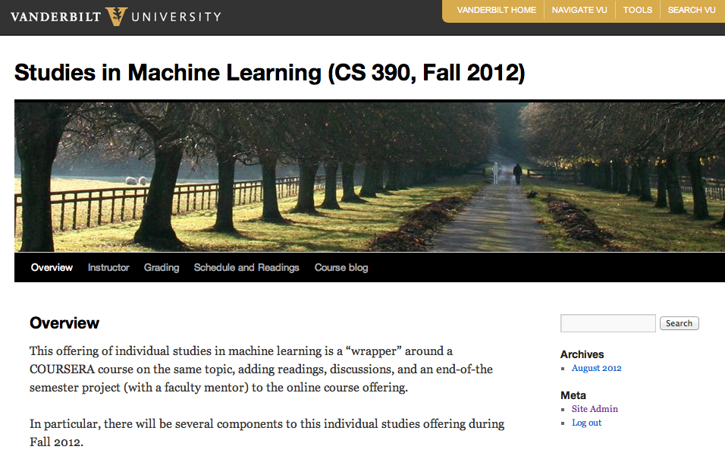

Slide 6
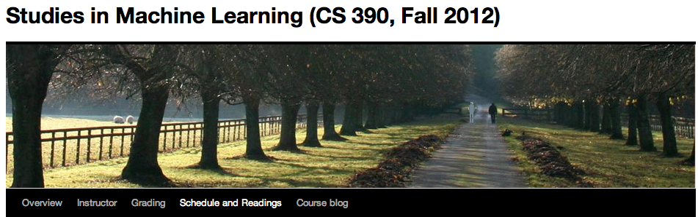
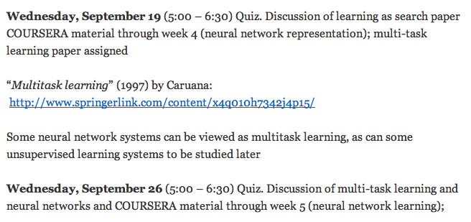

Slide 7
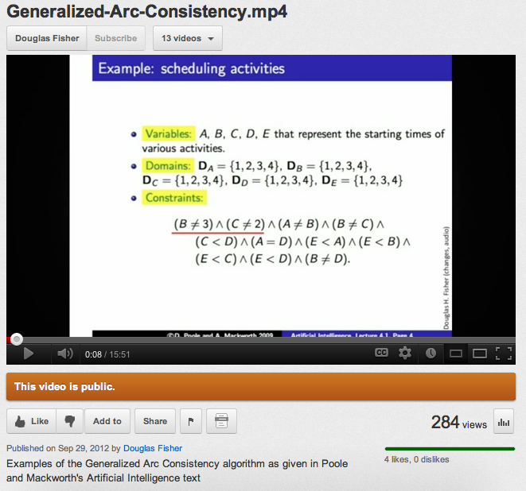
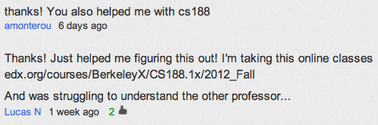
CS 260 AI Video call out from UC Berkeley MOOC

Slide 8
What had initially concerned me
What would students, faculty, and Vanderbilt think of my
“outsourcing” lectures?
What would I do in class if not lecture?
What gets me excited about unfolding online activity
I feel in community with other educators (for the first time in 25 years of teaching)
Creating and posting my own content
Even greater customization across courses and curricula
Other forms of crowd sourcing educational material (e.g., Wikibooks)
That students will see community modeled explicitly among their educators
Leveraging and creating across institution MOOCs

Slide 9
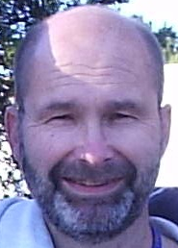
Creative, Serious and
Playful Science of
Android Apps
(UIUC)
An Online Computer Science Curriculum
(Technical Electives)
Software
Defined
Networks
(U Maryland)
Functional Programming
Principles in Scala
(Ecole Polytechnique)
Creative programing
For digital media &
Mobile Apps
(U of London)
Image
and Video
(Duke)
Malicious Software
underground story
(U of London)
Heterogeneous
Parallel
Programming
(Stanford)
Computational
Photography
(GaTech)
Web Intelligence
and Big Data
(IIT, Dehli)
Interactive
Programming
(Rice)
community
Computer Vision
(UC Berkeley)
Crytography
(Stanford)
Machine Learning
(Stanford)
Gamification
(U Penn)
Computer Vision
(Stanford/Michigan)
Applied
Crytography
(Udacity)
Machine Learning
(U Washington)
AI Planning
(Edinburgh)
Discrete
Optimization
(Melbourne)
Computing for
Data Analysis
(Johns Hopkins)
VLSI CAD:
Logic to Layout
(UIUC)
customization
NLP
(Stanford)
Networked Life (U Penn)
Douglas H. Fisher
Coding the Matrix: Linear Algebra
CS applications (Brown)
Social Network Analysis (Michigan)

Slide 10
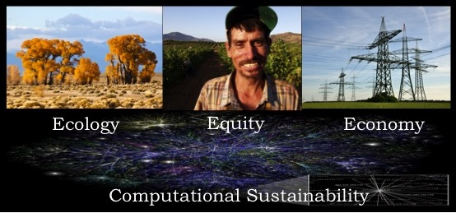
Incorporating Computational Sustainability into AI Education
through a
Freely-Available, Collectively-Composed Supplementary Lab Text
Douglas Fisher
Vanderbilt University
doug.fisher@vanderbilt.edu
Bistra Dilkina
Cornell University
bistra@cs.cornell.edu
Eric Eaton
Bryn Mawr College
eeaton@brynmawr.edu
Carla Gomes
Cornell University
gomes@cs.cornell.edu
https://en.wikibooks.org/wiki/Artificial_Intelligence_for_Computational_Sustainability:_A_Lab_Companion
The Introduction to Sustainability course from UIUC and offered on
COURSERA is using a (UIUC-crowd) sourced textbook
(http://cnx.org/content/col11325/latest)

Slide 11

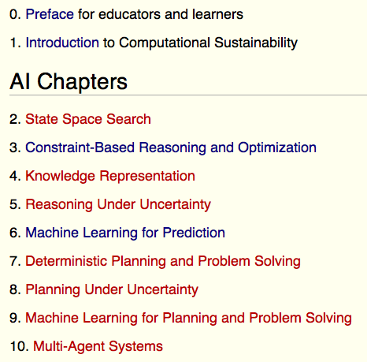
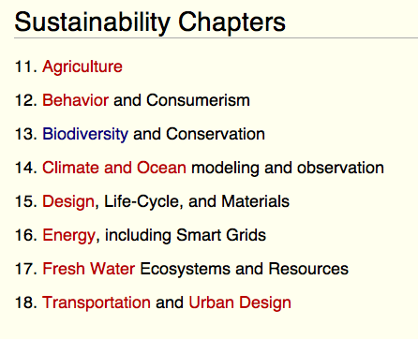
Artificial Intelligence for Computational Sustainability:
A Lab Companion

Slide 12
Final Thoughts
Embracing the materials of other professors at other institutions doesn’t come easy for lone wolves, but
I can’t imagine that we won’t see more of it
Will there be teaching stars? I don’t really care, so long as
  Any stars recognize that they are part of community
  I remain active and of utility in the community, even niche,
  My skills don’t atrophy (unanticipated consequence?)
  Diversity across content WITHIN topic (e.g., machine learning) doesn’t decrease (unanticipated consequence?)
How will the “scholarship” of educational material evolve?
Annotations, tools, acknowledgements, ontologies for
educational content

Slide 13
An Online Computer Science Curriculum (Basics)
Introduction to Logic
(Stanford)
Combinatorics
(Princeton)
Learn to Program:
Fundamentals
(Toronto)
Introduction to
Computer
Science 1 (Harvard)
and 2 (MIT)
CS 101
Introduction to
Computer Science
(Udacity)
Computer
Science
101
(Stanford)
“equivalent”
alternatives
Learn to Program:
Crafting
Quality Code
(Toronto)
CS 212
Design of
Computer Programs
(Udacity)
“equivalent”
alternatives
The Hardware/Software Interface (U Washington)
CS 215
Algorithms:
Crunching Social Networks
(Udacity)
Algorithms Part 1
(Princeton)
Algorithms:
Design and Analysis,
Part 1
(Stanford)
“equivalent”
alternatives
Douglas H. Fisher

Slide 14
An Online Computer Science Curriculum (Core)
“equivalent”
alternatives
Algorithms
Part 2
(Princeton)
Algorithms:
Design and Analysis,
Part 2 (Stanford)
Automata
(Stanford)
Programming Languages
(U Washington)
Compilers
(Stanford)
Pattern-Oriented
Software
Architectures
(Vanderbilt)
Design of
Computer Programs
(Udacity)
Software as a Service
(UC Berkeley)
Introduction to
Databases
(Stanford)
Computer
Architecture
(Princeton)
Computer
Networks
(U Washington)
CS188.1x
Artificial
Intelligence
(UC Berkeley)
CS373
Artificial
Intelligence
(Udacity)
Douglas H. Fisher

Slide 15
An Online Computer Science Curriculum
Tech/Soc
Writing in the Sciences
(Stanford)
Internet History, Technology, and Security
(Michigan)
Securing
Digital
Democracy
(Michigan)
Sci, Tech, Soc in China
(Hong Kong)
How to Build a Startup
(Udacity)
Computational
Investing
(GaTech)
Information Security
and Risk Management
in Context
(U Washington)
Online Games:
Literature,
New Media, and Narrative
(Vanderbilt)
Specialized
and Tutorial
Sciences, Humanities, Arts
few thus far, but enough
To fill out a “major”
MySQL Databases
For Beginners
(Udemy)
Differential
Equations
(Khan Academy)
Douglas H. Fisher

Slide 16
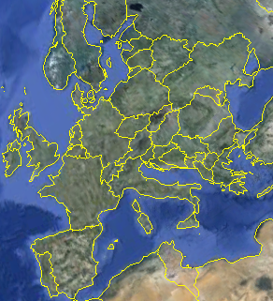
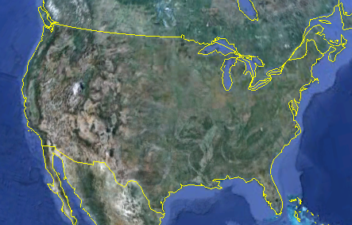
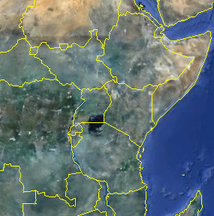
More on Distributed Shared Courses
Build on our previous course development activities (e.g., the highly interdisciplinary and popular “State of the Planet” course) by developing a distributed shared course across many institutions
Exploit existing infrastructure to develop and host courses
Virtual technology to manage lectures, and formal and informal discussion groups
Instill a commitment to place through local and regional “super sections, with course activities customized to regional challenges
Bologna
section
WC OR
section
Wisc Lake
section
Central NY
section
San Gabriel Valley
section
Mid Tennessee
section
Uganda
section
Douglas H. Fisher
One general theme: what will my region be like in 40 years?

Slide 17
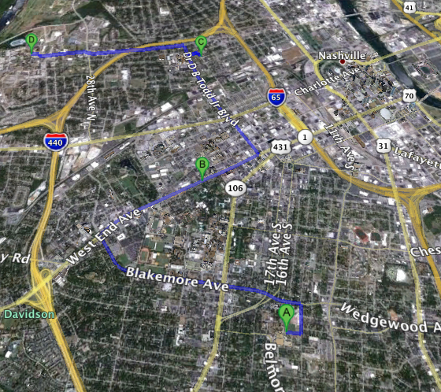
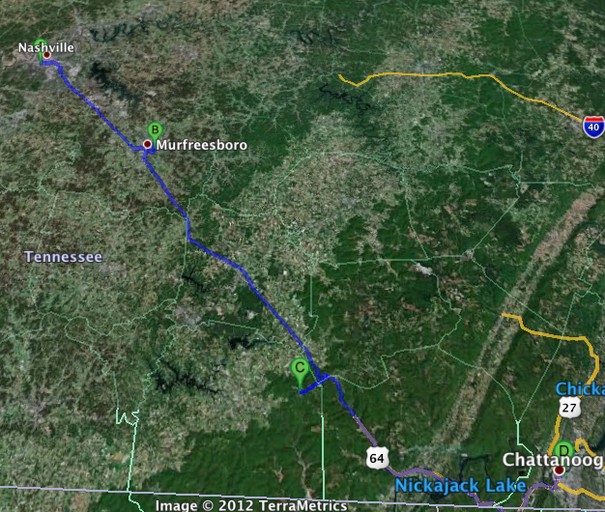


TSU
Possible participants in the Middle Tennessee
super section of the State of the Planet OOC
Fisk U
Vanderbilt U
Cumberland U
Local themes:
flooding,
green spaces,
historic districts
Belmont U
Middle Tennessee
State U
Douglas H. Fisher
NPO, Govt, Academic, Corporate advisors on local and regional issues
U of the
South
Regional themes:
water quality,
invasive species,
climate change
UT, Chat

