Slide 1
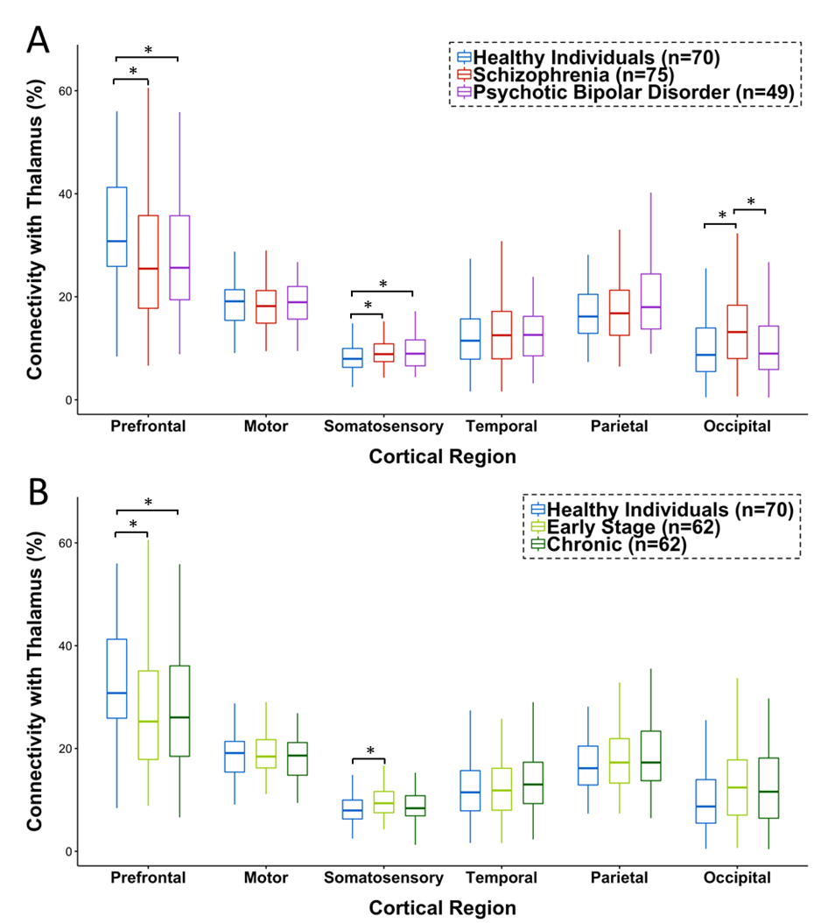
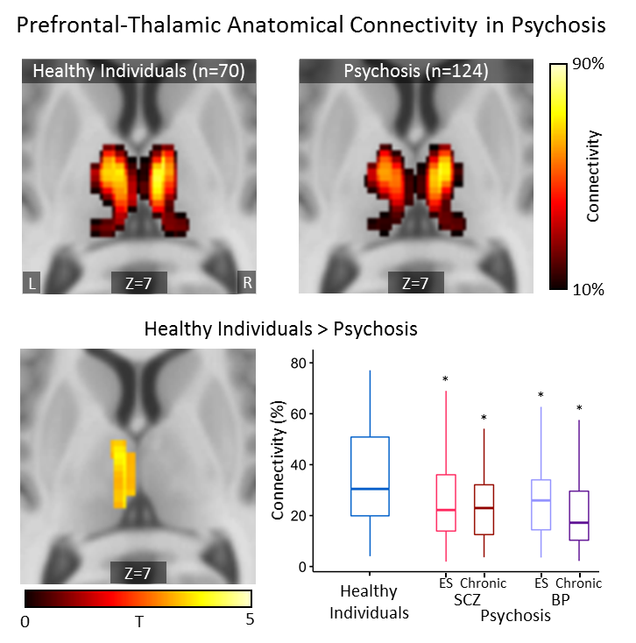
Thalamocortical anatomical connectivity in schizophrenia
and psychotic bipolar disorder
Julia M. Sheffield¹, Anna S. Huang¹, Monica Keith¹, Baxter Rogers², Stephan Heckers¹, Neil D. Woodward¹
¹ Vanderbilt University Medical Center, Department of Psychiatry & Behavioral Sciences
² Vanderbilt University Institute of Imaging Sciences
Background
Results
Results
Anatomical connectivity between the prefrontal cortex (PFC) and thalamus is reduced in schizophrenia and associated with cognitive impairment¹. Overlapping phenotypes, including deficits in cognitive abilities dependent on PFC-thalamic circuitry², suggest dysrupted thalamocortical anatomical connectivity may extend to psychotic bipolar disorder. The current study seeks to:
Test the hypothesis that altered thalamocortical anatomical connectivity, reduced PFC-thalamic connectivity specifically, extends to psychotic bipolar disorder.
Determine if abnormalities in thalamocortical anatomical connectivity are present in both the early and chronic stages of psychosis.
Characterize the associations between PFC-thalamic connectivity and impaired executive cognitive abilities in psychosis.
Thalamocortical Anatomical Connectivity in Psychotic Disorders
PFC-Thalamic Anatomical Connectivity Across Illness Stage and Psychotic Disorder
*p<.05
Thalamocortical Anatomical Connectivity in Early Stage and Chronic Psychosis
*p<.05
Methods
Conclusions
Reduced PFC-thalamic anatomical connectivity observed in schizophrenia extends to psychotic bipolar disorder
Presence of similar alterations across illness stages is consistent with atypical brain development in psychotic disorders
Hypothesized associations between reduced PFC-thalamic anatomical connectivity and cognitive impairment were not observed (data not shown)
Associations are likely weak and/or correlated with more proximal neural measures, such as brain function/connectivity during task performance
*p<.05
Thalamocortical Anatomical Connectivity in Psychotic Disorders: Voxel-Wise Analysis
Neuroimaging (3T)
T1-weighted structural scan (1 mm isotropic resolution)
High-angular radial diffusion-weighted imaging (HARDI) scan (60 directions, 2.5 mm isotropic resolution)
Anatomical Segmentation
T1 anatomical images segmented to delineate thalamus and 6 cortical regions-of-interest (ROIs): PFC, temporal, motor, somatosensory, parietal, occipital
Thalamocortical Anatomical Connectivity
Seed (thalamus) to target (cortical ROIs) tractography analyses performed using FSL probtrackx2³
Total connectivity of each cortical ROI with the thalamus calculated and used as dependent variables in primary analyses
Primary analysis complemented with voxel-wise analyses
References
Giraldo-Chica M, Rogers BP, Damon SM, Landman BA, Woodward ND. Prefrontal-Thalamic Anatomical Connectivity and Executive Cognitive Function in Schizophrenia. Biol Psychiatry 83(6), 509-517. 3-15-2018.
Bora E, Yucel M, Pantelis C. Cognitive functioning in schizophrenia, schizoaffective disorder and affective psychoses: meta-analytic study. Br.J.Psychiatry 195(6), 475-482. 2009.
Behrens TE, Berg HJ, Jbabdi S, Rushworth MF, Woolrich MW. Probabilistic diffusion tractography with multiple fibre orientations: What can we gain? Neuroimage 34(1), 144-155. 1-1-2007.
This work was supported by NIMH grants R01 MH102266 (NDW) and the Charlotte and Donald Test Fund
Thresholded at cluster-level p-value (family-wise error (FWE) corrected)=.05 for voxel-wise p=.001 (uncorrected)
Correspondence to: Julia.Sheffield@vumc.org
PDF available at: www.woodwardlab.com

