Slide 1
Crucial Contexts
Exploring Caribbean/American Histories
Ifeoma C.K. Nwankwo, Ph.D.
Associate Professor
Vanderbilt University

Slide 2
Haitian Compas Music
https://www.youtube.com/watch?v=mS66Z4iuEHM

Slide 3
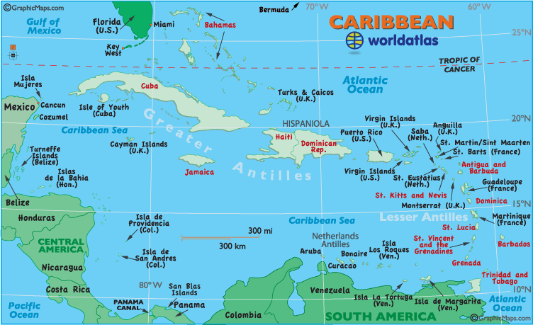

Slide 4
The Haitian Revolution
“Where Negritude stood up for the first time”
(Aime Cesaire)
Call to action led by enslaved man named Boukman
Toussaint L’Ouverture– head of new nation
1791-1804
http://library.brown.edu/haitihistory/5.html

Slide 5
The Haitian Revolution
Fear that the revolution would spread
Pride
Martin Delany
Blake; Or The Huts of America (1853)
David Walker
Appeal to the Colored Citizens of the World (1829)
1791-1804
https://www.youtube.com/watch?v=IOGVgQYX6SU

Slide 6
Caribbean/American Histories Part 1
https://history.state.gov/milestones/1784-1800/haitian-rev
http://www.ugapress.org/index.php/books/haiti_and_united_states
http://www.inmotionaame.org/print.cfm;jsessionid=f830695521429836311614?migration=5&bhcp=1

Slide 7
Caribbean/American Histories Part 2
https://history.state.gov/milestones/1914-1920/haiti
http://windowsonhaiti.com/windowsonhaiti/am-occup.htm
http://sites.duke.edu/haitilab/english/the-united-states-occupation/

Slide 8
Caribbean/American Histories Part 3
Haitian Immigration
http://www.inmotionaame.org/migrations/landing.cfm?migration=12&bhcp=1
http://lyrics-translations.com/song/show/1694780/wyclef-jean/lyrics-and-translation-jaspora/

Slide 9
Caribbean/American Women’s (Hi)Stories
The History of Mary Prince, A West Indian Slave (1831)
“I have been a slave myself – I know what slaves feel – I can tell by myself what other slaves feel, and by what they have told me.”
“They hire servants in England. . . They have their liberty. That’s just what we want. We don’t mind hard work, if we had proper treatment, and proper wages like English servants, and proper time given in the week to keep us from breaking the Sabbath.”

Slide 10
Caribbean/American Women’s (Hi)Stories
Una Marson
http://www.dloc.com/UF00077397/00001/1j?search=marson
http://www.dloc.com/results/?t=una%20marson

Slide 11
Caribbean/American Women’s (Hi)Stories
Louise Bennett
http://louisebennett.com/
http://www.folkways.si.edu/louise-bennett/jamaican-folk-songs/caribbean-world/music/album/smithsonian
“Proverbs” poem
‘Wen ashes cowl dawg sleep in dey’
Far sence Ma dead yuh see,
All kine o’ old black nayga start
Teck libaty wid me.

Slide 12
Caribbean/American Women’s (Hi)Stories
“[Haitian] women have been and continue to be an important part of the revolutionary undercurrents that have enabled generation upon generation of Haitians, following the independence of 1804, to survive an endless succession of dictatorial governments” (Chancy 5)

Slide 13
Caribbean/American Women’s (Hi)Stories
“Thus, social and literary ‘History’ are both . . .‘man’-made artifacts that are meant to make sense of the ‘incomprehensible’ sequence of events populating the cultural life of nations but fail to do so. . . When a population is considered so insignificant that its existence goes undocumented, storytelling becomes, necessarily, a source of retrieval; a story must be imagined, a fiction created, that will stand the stress of devaluation” (15).

Slide 14
Caribbean/American Women’s (Hi)Stories

Slide 15
Caribbean/American Women’s (Hi)Stories
https://www.ted.com/talks/edwidge_danticat_stories_of_haiti
http://www.npr.org/2013/08/25/214857669/haitian-youth-illuminated-in-sea-light

Slide 16
Caribbean/American Women’s (Hi)Stories
“Since a codified history of Haitian women has yet to be written, the project of recovering the roots of Haitian women’s self-definition is made possible only through the evaluation of narrative form. . . [W]ritings by women of color in the United States as well as in the Third World reveal that the creation of identity in the face of . . . oppression begins with the transmutation of the personal into the creative, into modes of self-empowerment that in and of themselves create a theory of self-definition.”
(Chancy 6)

Slide 17
Caribbean/American Women’s (Hi)Stories

